Slide 1

BUDDY – EXPENSE TRACKER AND BUDGETING APP
INFO6150 Final Project
Ramya Devie Saravana bhava - 002770163
Disha Sunil Patil - 002768900
Jiale Lyu - 002722692
Zhifei Li - 002708724

Slide 2
Purpose
Replaces orthodox pen and paper approach
Allows the user to log their expenses and shows statistical spending data using graphs
Helps user to be accountable financially by helping them to stay in their budget
Reduces financial spending and avoid debt

Slide 3
Features
User registration and login
User can do CRUD (create/read/update/delete) operations in expense event
User can set budget limits on categories and when they exceed the limit a warning notification will be sent to user email
User can create shopping checklist and mark the item as complete
System generates statistic charts and graphs (based on categories)

Slide 4
Tech Stack
Nextjs - handles the tooling and configuration needed for React
Bcrypt - Password encrypt library for password hashing
JsonWebToken - User authentication
emailjs - API used to send email to the user
echarts - API used to display statistical financial data to the user
Mongodb Atlas Cloud – cloud database that handles all the complexity of deploying, managing, and healing your deployments
Sass - boosts your performance and avoids repetition of the same CSS property and their assigned values by using mixins and variables

Slide 5
References
https://developer.mozilla.org/en-US/
https://nextjs.org/docs/api-routes/dynamic-api-routes
https://developer.mozilla.org/en-US/docs/Web/Web_Components
https://echarts.apache.org/en/index.html
https://www.emailjs.com/docs/
https://www.npmjs.com/package/bcrypt
https://jwt.io/libraries
https://www.mongodb.com/atlas/database

Slide 6
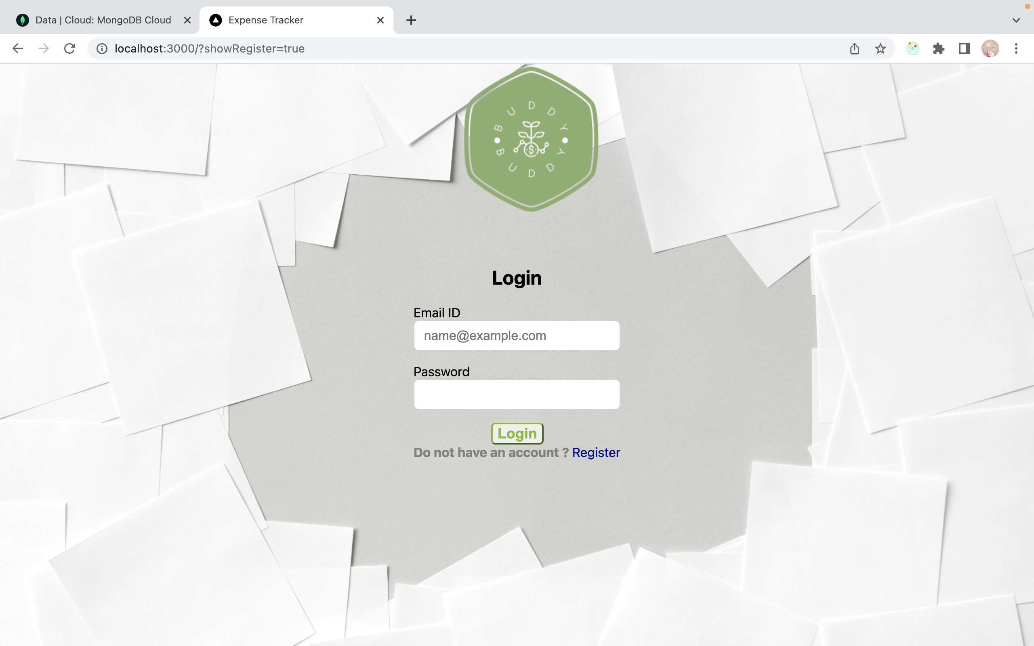
Login Page

Slide 7
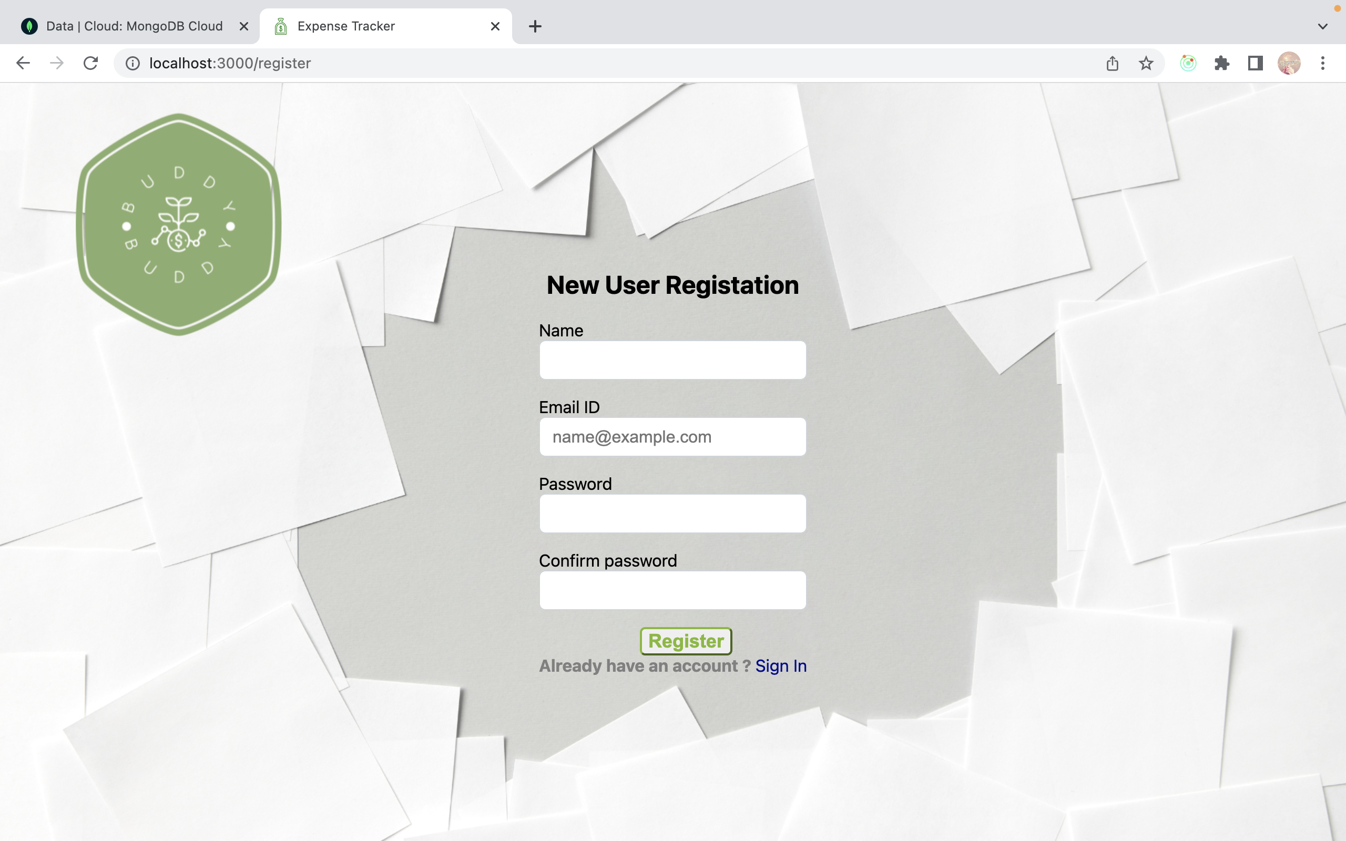
User Registration Page

Slide 8
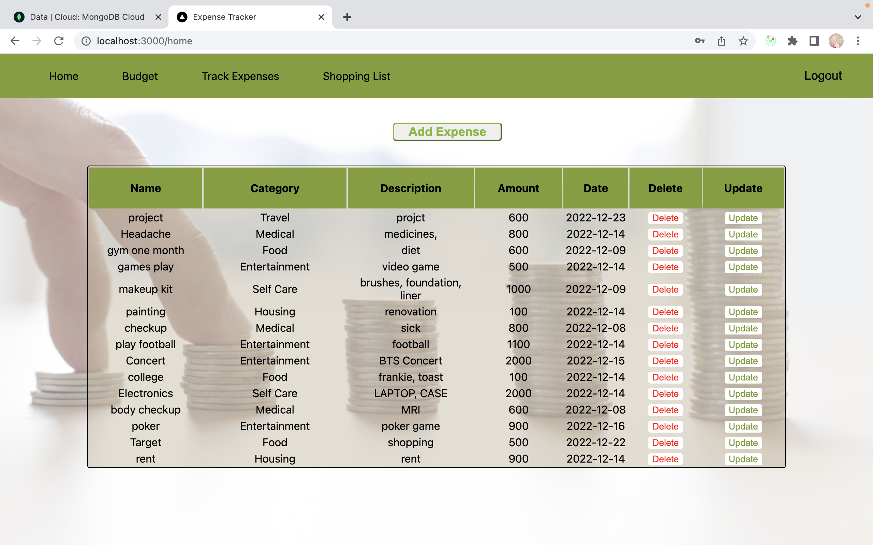
User Home Page

Slide 9
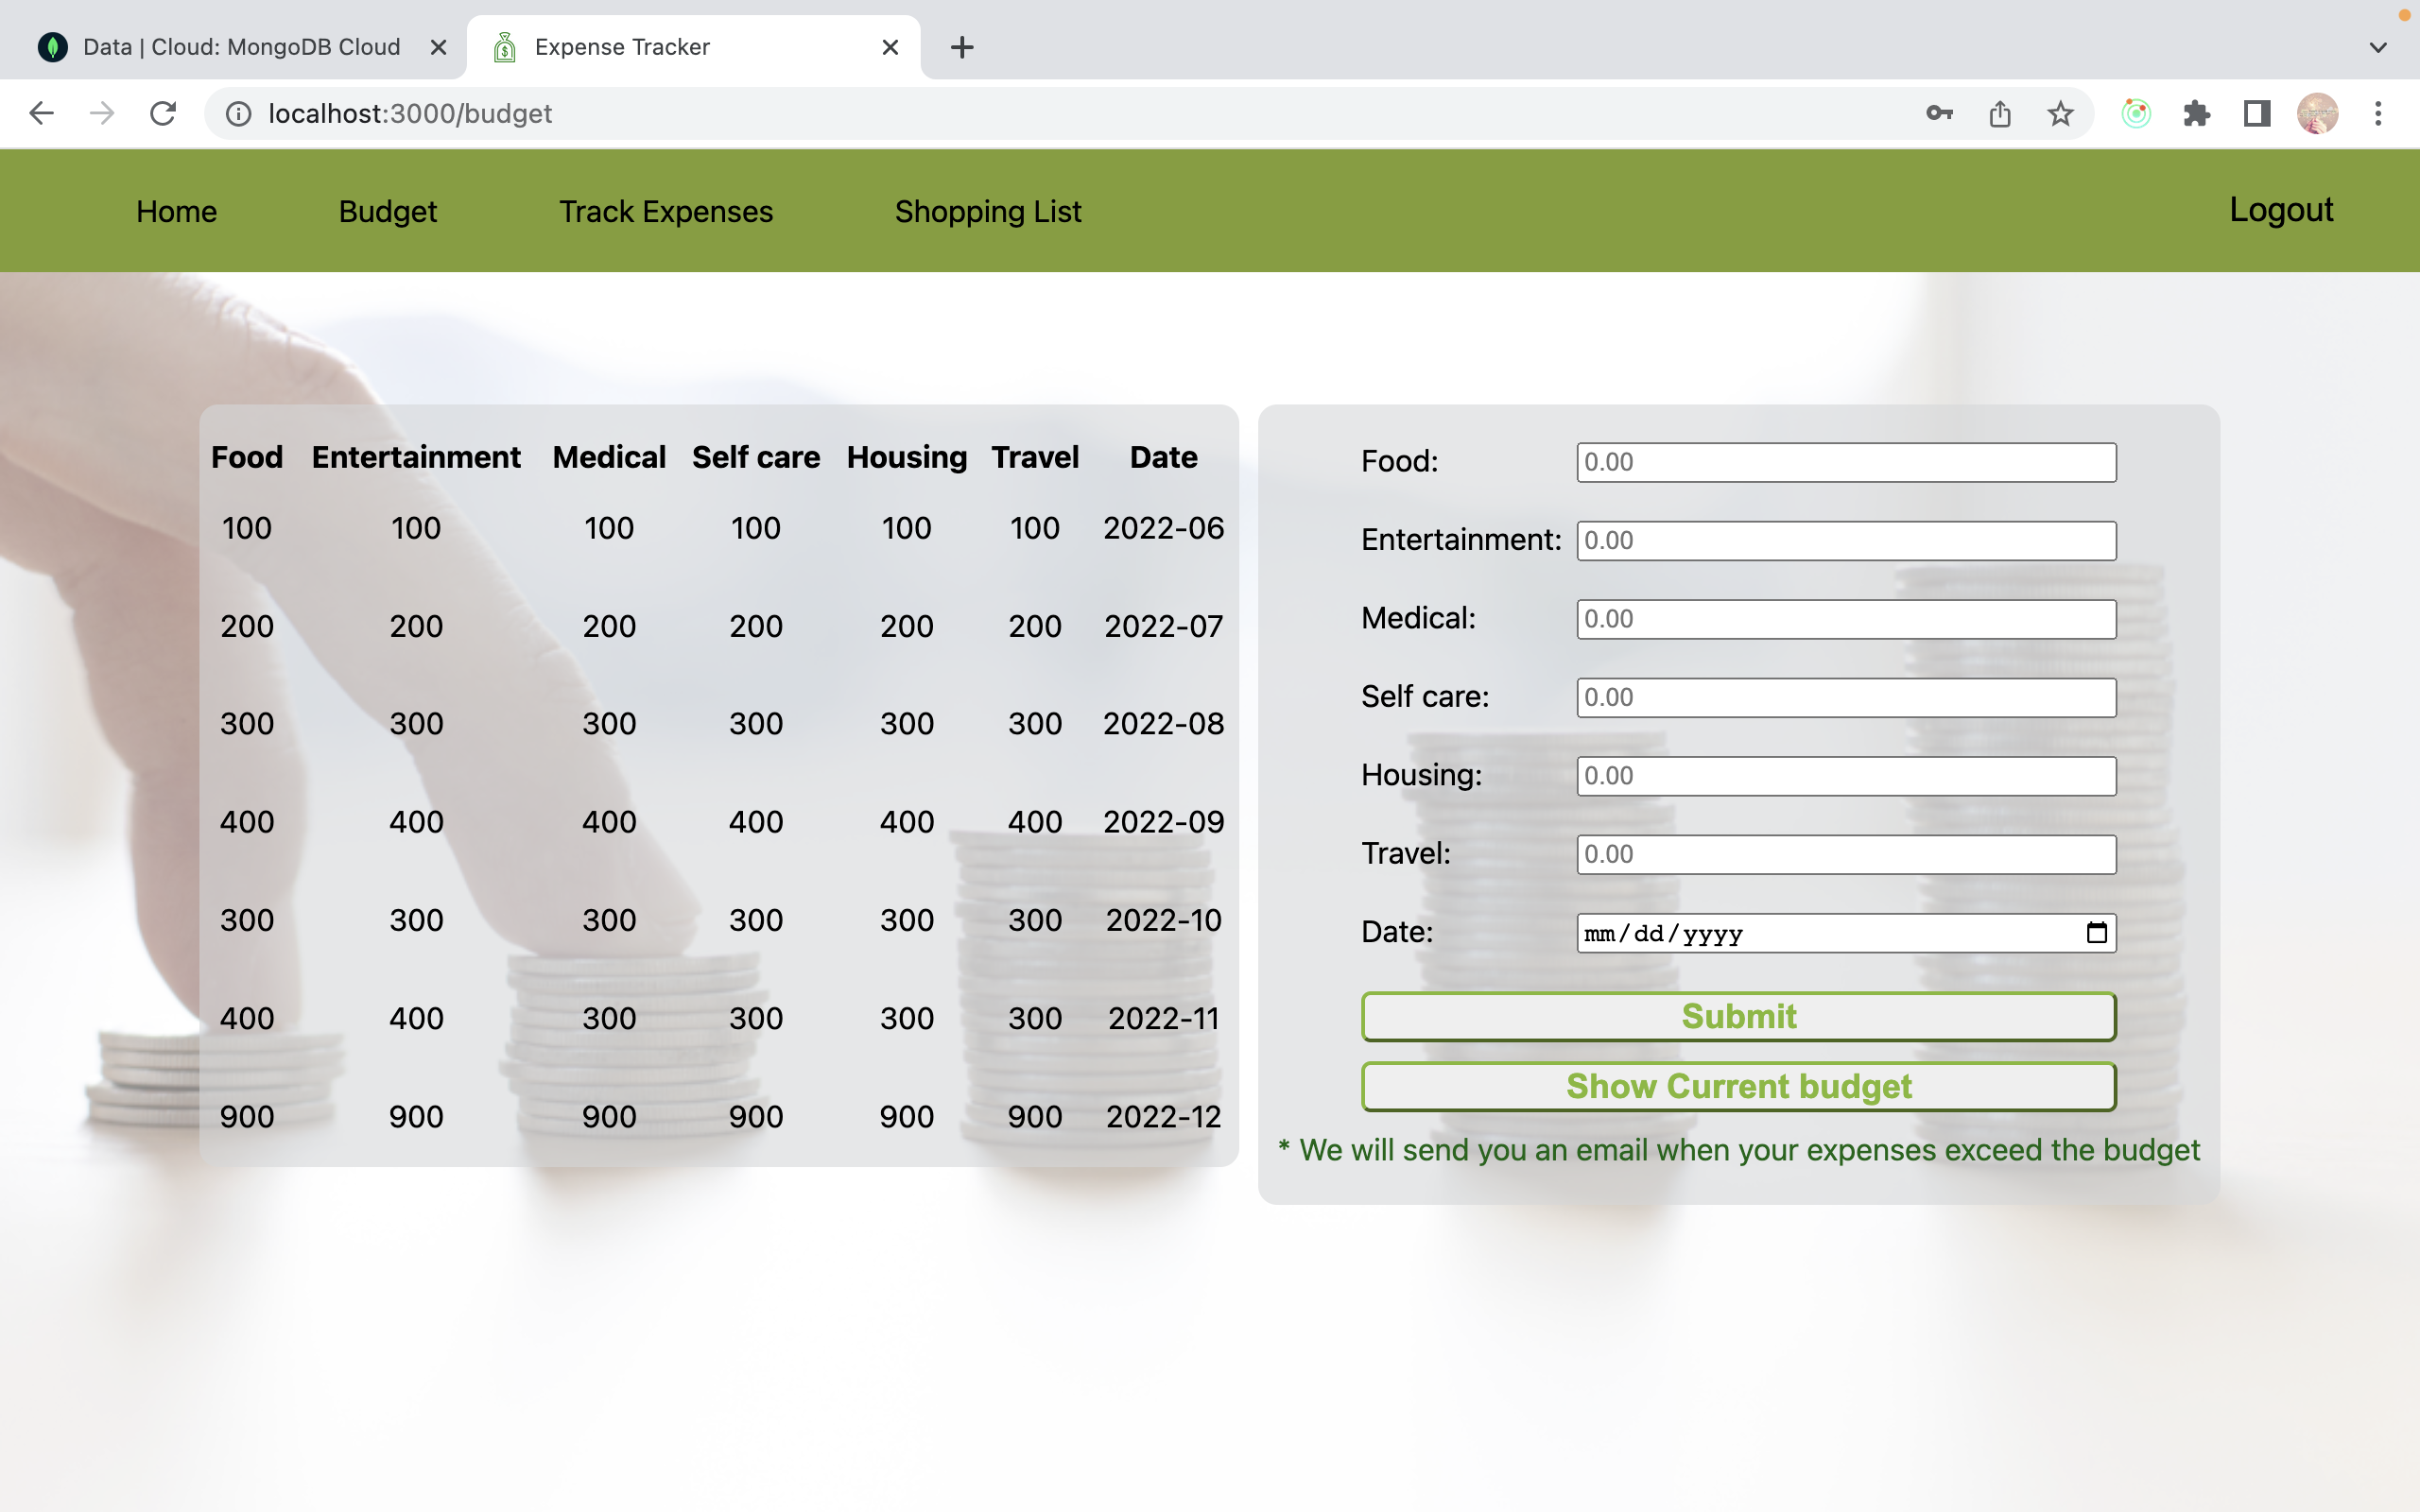
User Budget Page

Slide 10
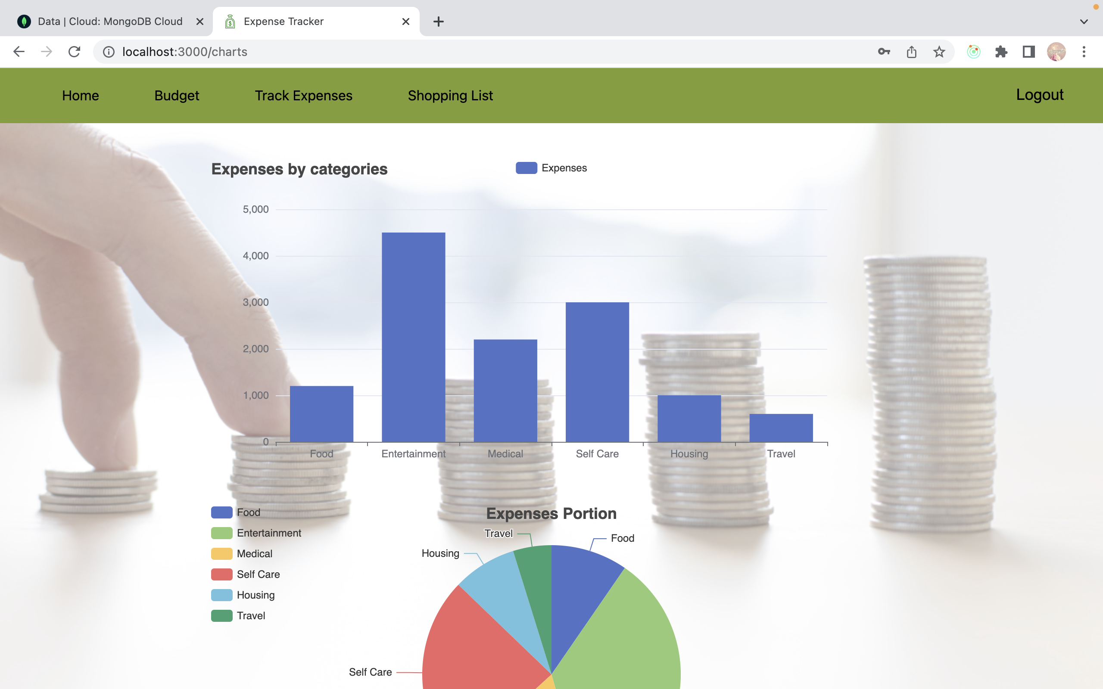
Track Expenses page

Slide 11
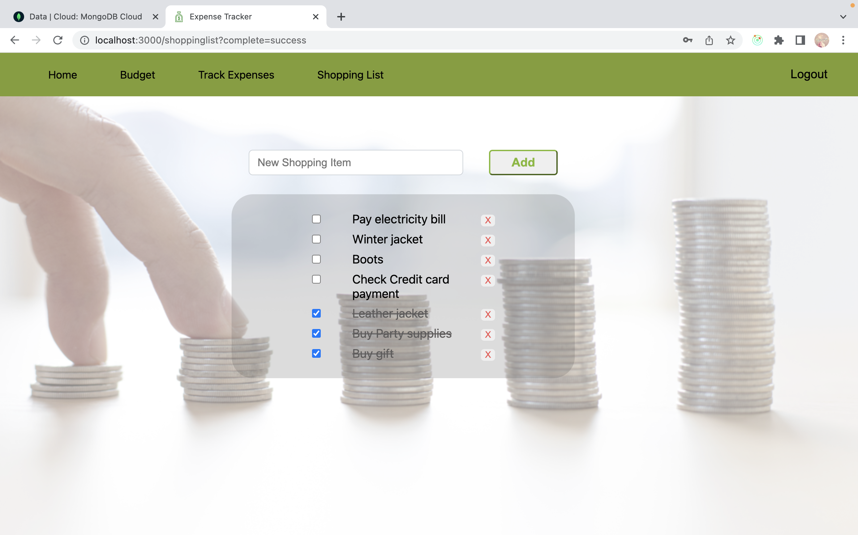
Shopping List Page

